Slide 1
CSE470: Software Engineering
Layered Architecture

Slide 2
Monolithic Software
The end product come at end of the process model
There is no separation of concern (code) of different software components.
All code may be written in a single file with html, sql queries, logic checking etc.

Slide 3
Problems of Monolithic Software
No separation between components
Changing a component affects other components.
For example – What if I want to change the UI from JavaScript to Angular ?

Slide 4
What is Layered Architecture
Organises the system into a set of layers (or abstract machines) each of which provide a set of services.
Supports the incremental development of sub-systems in different layers. When a layer interface changes, only the adjacent layer is affected.

Slide 5
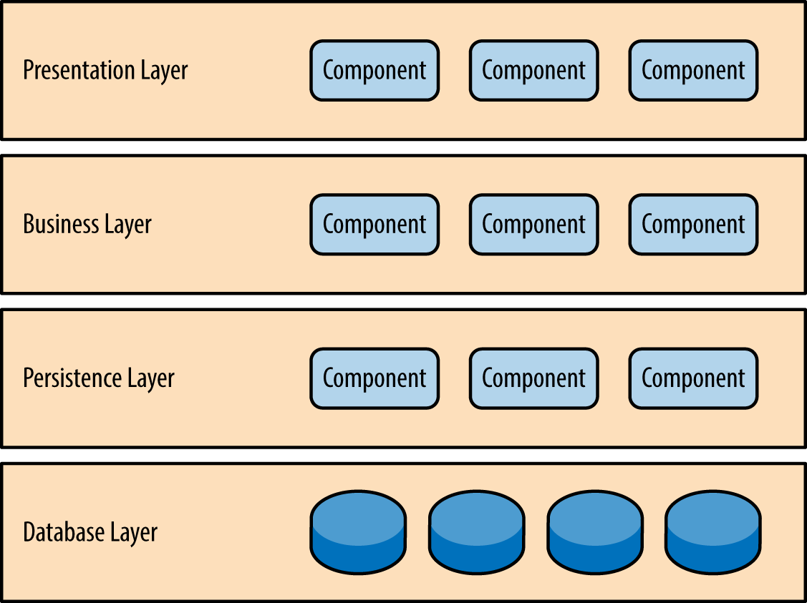
Layered Architecture
Organises the system into a set of layers (or abstract machines) each of which provide a set of services.
Supports the incremental development of sub-systems in different layers. When a layer interface changes, only the adjacent layer is affected.

Slide 6
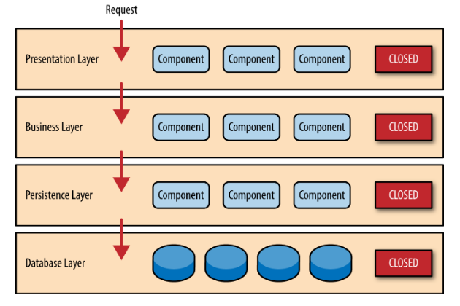
Layered Architecture
Layers can be open or closed
A closed layer can only be accessed by the layer above.
A change in one layer does not affect others. It provides isolation.
However, what if we want to add a new layer where shared utilities will be provided to be used by the Business Layer. But, we need to use it sometimes.

Slide 7
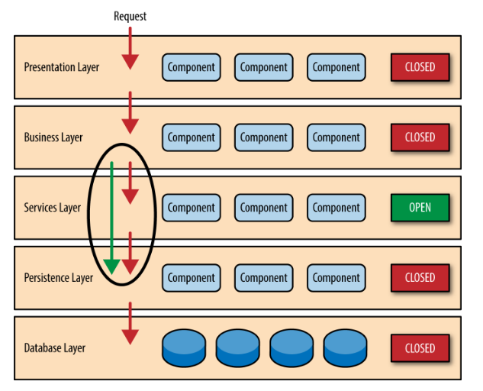
Layered Architecture
Here comes the concept of open layers.
An open can be bypassed by upper layers.
Too many open layers may affect the actual essence of layered architecture.

Slide 8
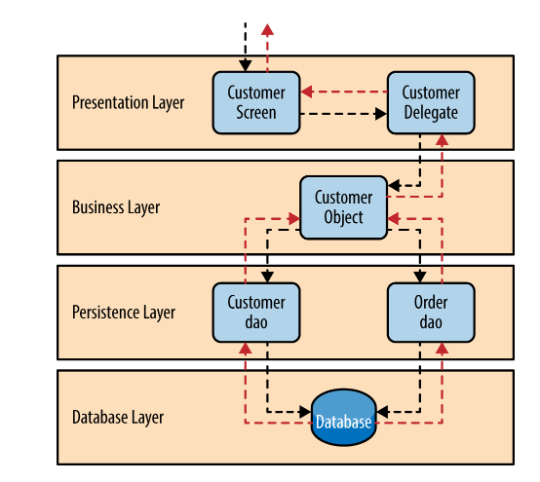
Example

Slide 9
When Used
Used when building new facilities on top of existing systems
When the development is spread across several teams with each team responsible for a layer of functionality
When there is a requirement for multi-level security (for instance, any secured transaction based system)

Slide 10
Advantages-Disadvantages
Advantages
Allows easy replacement or addition of entire layers so long as the interface is maintained.
Testing is easy as components are isolated
Disadvantages
In practice, providing a clean separation between layers is often difficult and a high-level layer may have to interact directly with lower-level layers rather than through the layer immediately below it.
Performance can be a problem because of multiple levels of interpretation of a service request as it is processed at each layer.
Parallel processing is not possible (Sequential structure)
Example: OSI model, J2EE/Java 2 Enterprise Edition programming model

